Slide 1
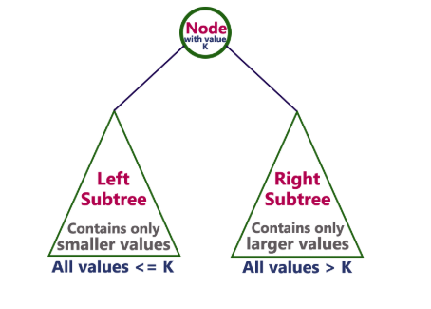
Binary Tree:
In a binary tree, every node can have a maximum of two children but there is no need to maintain the order of nodes basing on their values. In a binary tree, the elements are arranged in the order they arrive at the tree from top to bottom and left to right.
To enhance the performance of binary tree, we use a special type of binary tree known as Binary Search Tree. Binary search tree mainly focuses on the search operation in a binary tree.
Binary Search Tree:
Binary Search Tree is a binary tree in which every node contains only smaller values in its left subtree and only larger values in its right subtree.

Slide 2
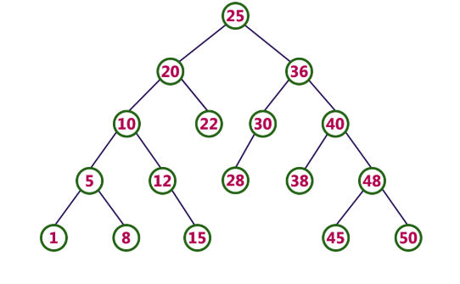
Example
The following tree is a Binary Search Tree. In this tree, left subtree of every node contains nodes with smaller values and right subtree of every node contains larger values.
Every binary search tree is a binary tree but every binary tree need not to be binary search tree.
Operations on a Binary Search Tree
The following operations are performed on a binary search tree...
Search
Insertion
Deletion

Slide 3
Search Operation in BST
In a binary search tree, the search operation is performed with O(log n) time complexity. The search operation is performed as follows...
Step 1 - Read the search element from the user.
Step 2 - Compare the search element with the value of root node in the tree.
Step 3 - If both are matched, then display "Given node is found" and terminate the function
Step 4 - If both are not matched, then check whether search element is smaller or larger than that node value.
Step 5 - If search element is smaller, then continue the search process in left subtree.
Step 6- If search element is larger, then continue the search process in right subtree.
Step 7 - Repeat the same until we find the exact element or until the search element is compared with the leaf node
Step 8 - If we reach to the node having the value equal to the search value then display "Element is found" and terminate the function.
Step 9 - If we reach to the leaf node and if it is also not matched with the search element, then display "Element is not found" and terminate the function.

Slide 4
Insertion Operation in BST
In a binary search tree, the insertion operation is performed with O(log n) time complexity. In binary search tree, new node is always inserted as a leaf node. The insertion operation is performed as follows...
Step 1 - Create a newNode with given value and set its left and right to NULL.
Step 2 - Check whether tree is Empty.
Step 3 - If the tree is Empty, then set root to newNode.
Step 4 - If the tree is Not Empty, then check whether the value of newNode is smaller or larger than the node (here it is root node).
Step 5 - If newNode is smaller than or equal to the node then move to its left child. If newNode is larger than the node then move to its right child.
Step 6- Repeat the above steps until we reach to the leaf node (i.e., reaches to NULL).
Step 7 - After reaching the leaf node, insert the newNode as left child if the newNode is smaller or equal to that leaf node or else insert it as right child.

Slide 5
Deletion Operation in BST
In a binary search tree, the deletion operation is performed with O(log n) time complexity. Deleting a node from Binary search tree includes following three cases...
Case 1: Deleting a Leaf node (A node with no children)
Case 2: Deleting a node with one child
Case 3: Deleting a node with two children
Case 1: Deleting a leaf node
We use the following steps to delete a leaf node from BST...
Step 1 - Find the node to be deleted using search operation
Step 2 - Delete the node using free function (If it is a leaf) and terminate the function.
Case 2: Deleting a node with one child
We use the following steps to delete a node with one child from BST...
Step 1 - Find the node to be deleted using search operation
Step 2 - If it has only one child then create a link between its parent node and child node.
Step 3 - Delete the node using free function and terminate the function.

Slide 6
Case 3: Deleting a node with two children
We use the following steps to delete a node with two children from BST...
Step 1 - Find the node to be deleted using search operation
Step 2 - If it has two children, then find the largest node in its left subtree (OR) the smallest node in its right subtree.
Step 3 - Swap both deleting node and node which is found in the above step.
Step 4 - Then check whether deleting node came to case 1 or case 2 or else goto step 2
Step 5 - If it comes to case 1, then delete using case 1 logic.
Step 6- If it comes to case 2, then delete using case 2 logic.
Step 7 - Repeat the same process until the node is deleted from the tree.

Slide 7
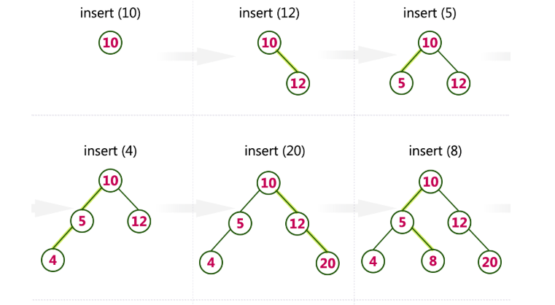
Example
Construct a Binary Search Tree by inserting the following sequence of numbers... 10,12,5,4,20,8,7,15 and 13

Slide 8
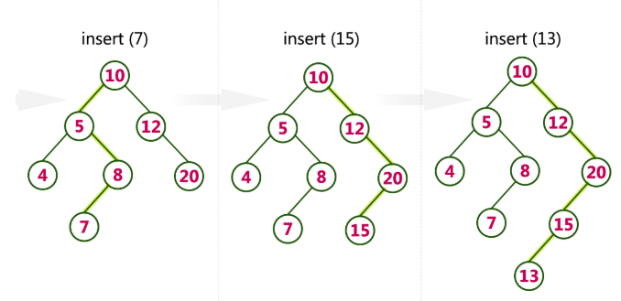

Slide 9
AVL Tree:
The AVL tree was introduced in the year 1962 by G.M. Adelson-Velsky and E.M.Landis.
AVL tree is a height-balanced binary search tree. That means, an AVL tree is also a binary search tree but it is a balanced tree.
In an AVL tree, every node maintains an extra information known as balance factor.
balance factor is difference between the heights of left and right subtrees of every node in the tree is either -1, 0 or +1.
The balance factor of a node is calculated either height of left subtree - height of right subtree (OR) height of right subtree - height of left subtree.
balance factor=height of left subtree-height of right subtree
balance factor of every node is either -1, 0 or +1.
Every AVL Tree is a binary search tree but every Binary Search Tree need not be AVL tree.

Slide 10
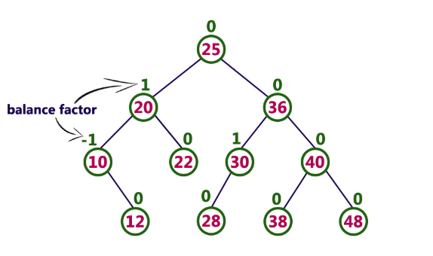
Example of AVL Tree:
AVL Tree Rotations:
In AVL tree, after performing operations like insertion and deletion we need to check the balance factor of every node in the tree.
If every node satisfies the balance factor condition then we conclude the operation otherwise we must make it balanced.
Whenever the tree becomes imbalanced due to any operation we use rotation operations to make the tree balanced.
Rotation operations are used to make the tree balanced.
Rotation is the process of moving nodes either to left or to right to make the tree balanced.

Slide 11
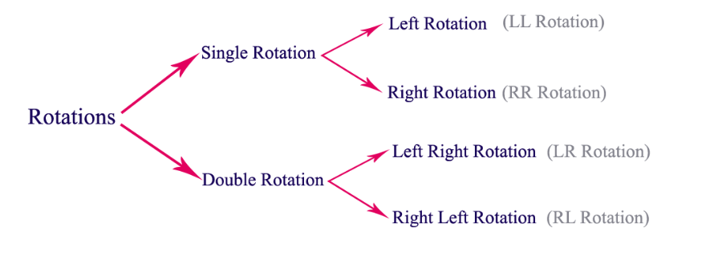
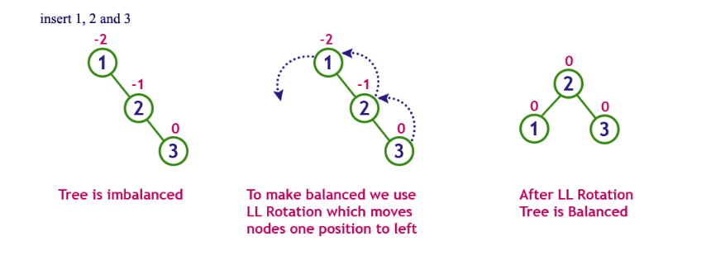
There are four rotations and they are classified into two types.
Single Left Rotation (LL Rotation)
In LL Rotation, every node moves one position to left from the current position. To understand LL Rotation, let us consider the following insertion operation in AVL Tree...

Slide 12
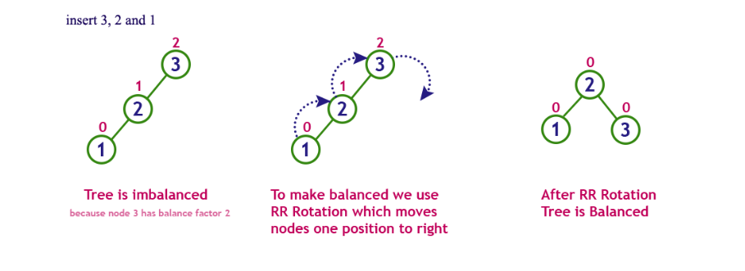
Single Right Rotation (RR Rotation)
In RR Rotation, every node moves one position to right from the current position. To understand RR Rotation, let us consider the following insertion operation in AVL Tree...

Slide 13
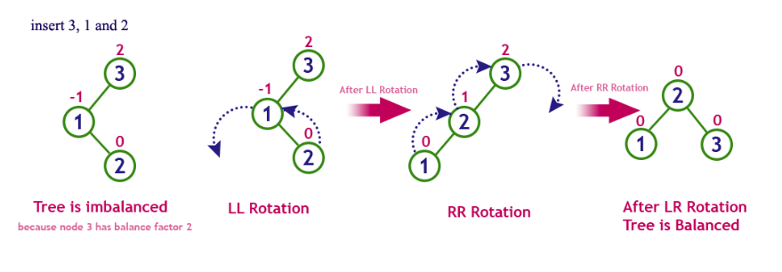
Left Right Rotation (LR Rotation)
The LR Rotation is a sequence of single left rotation followed by a single right rotation.
In LR Rotation, at first, every node moves one position to the left and one position to right from the current position....

Slide 14
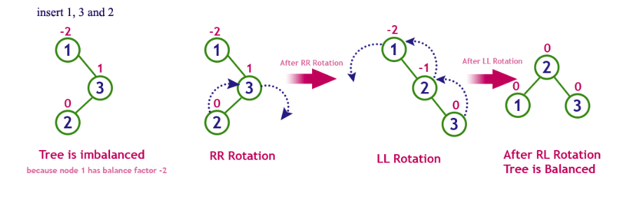
Right Left Rotation (RL Rotation)
The RL Rotation is sequence of single right rotation followed by single left rotation. In RL Rotation, at first every node moves one position to right and one position to left from the current position. To understand RL Rotation, let us consider the following insertion operation in AVL Tree...

Slide 15
Operations on an AVL Tree
The following operations are performed on AVL tree...
Search
Insertion
Deletion
Search Operation in AVL Tree
In an AVL tree, the search operation is performed with O(log n) time complexity. The search operation in the AVL tree is similar to the search operation in a Binary search tree. We use the following steps to search an element in AVL tree...
Step 1 - Read the search element from the user.
Step 2 - Compare the search element with the value of root node in the tree.
Step 3 - If both are matched, then display "Given node is found!!!" and terminate the function
Step 4 - If both are not matched, then check whether search element is smaller or larger than that node value.
Step 5 - If search element is smaller, then continue the search process in left subtree.
Step 6 - If search element is larger, then continue the search process in right subtree.
Step 7 - Repeat the same until we find the exact element or until the search element is compared with the leaf node.
Step 8 - If we reach to the node having the value equal to the search value, then display "Element is found" and terminate the function.
Step 9 - If we reach to the leaf node and if it is also not matched with the search element, then display "Element is not found" and terminate the function.

Slide 16
Insertion Operation in AVL Tree
In an AVL tree, the insertion operation is performed with O(log n) time complexity. In AVL Tree, a new node is always inserted as a leaf node. The insertion operation is performed as follows...
Step 1 - Insert the new element into the tree using Binary Search Tree insertion logic.
Step 2 - After insertion, check the Balance Factor of every node.
Step 3 - If the Balance Factor of every node is 0 or 1 or -1 then go for next operation.
Step 4 - If the Balance Factor of any node is other than 0 or 1 or -1 then that tree is said to be imbalanced. In this case, perform suitable Rotation to make it balanced and go for next operation.

Slide 17
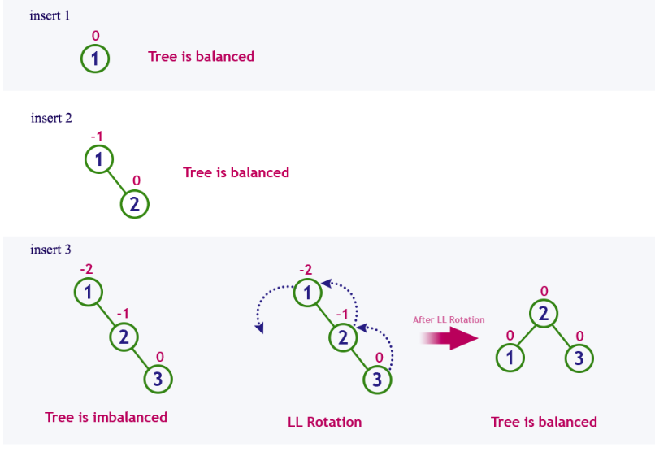
Example:
Construct an AVL Tree by inserting numbers from 1 to 8.

Slide 18
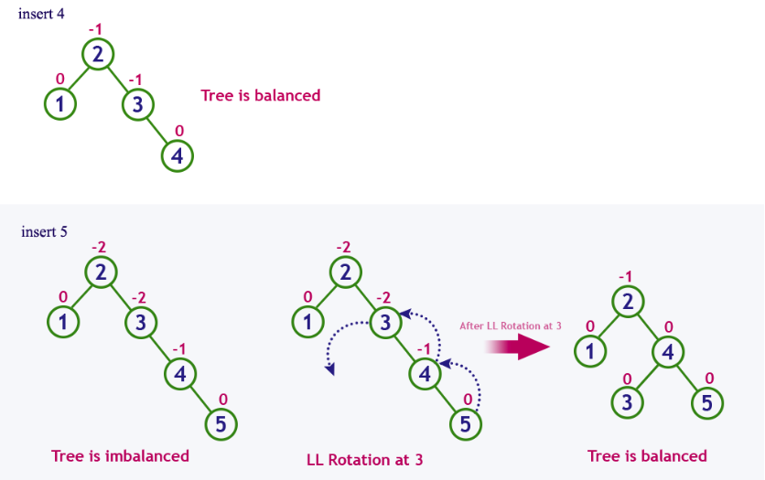

Slide 19
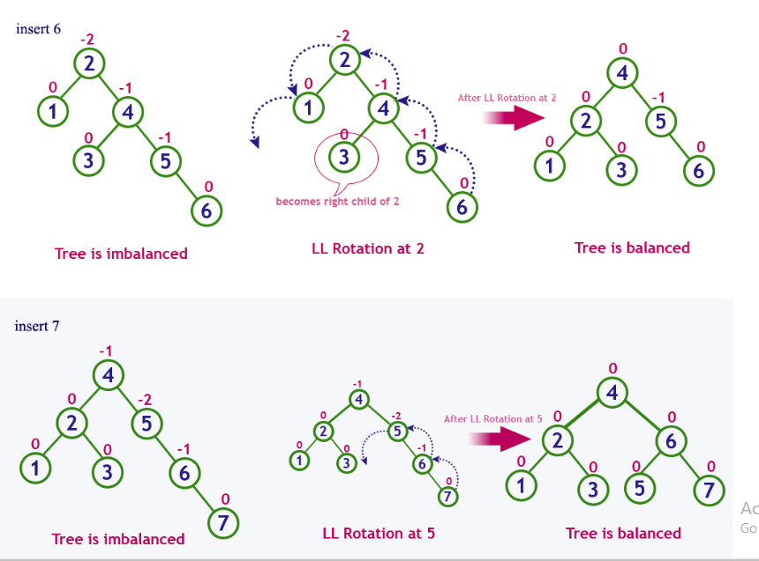

Slide 20
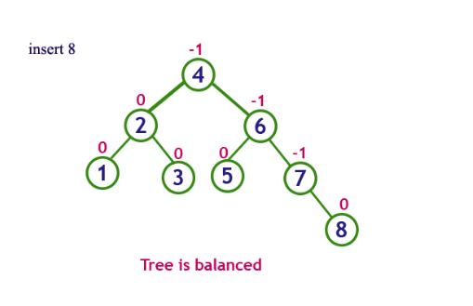
Deletion Operation in AVL Tree
The deletion operation in AVL Tree is similar to deletion operation in BST. But after every deletion operation, we need to check with the Balance Factor condition. If the tree is balanced after deletion go for next operation otherwise perform suitable rotation to make the tree Balanced.

Slide 21
Splay Tree:
Splay tree is another variant of a binary search tree. In a splay tree, recently accessed element is placed at the root of the tree.
Splay Tree is a self - adjusted Binary Search Tree in which every operation on element rearranges the tree so that the element is placed at the root position of the tree.
In a splay tree, every operation is performed at the root of the tree. All the operations in splay tree are involved with a common operation called "Splaying".
Splaying an element, is the process of bringing it to the root position by performing suitable rotation operations.
Every operation on splay tree performs the splaying operation. For example, the insertion operation first inserts the new element using the binary search tree insertion process, then the newly inserted element is splayed so that it is placed at the root of the tree. The search operation in a splay tree is nothing but searching the element using binary search process and then splaying that searched element so that it is placed at the root of the tree.

Slide 22
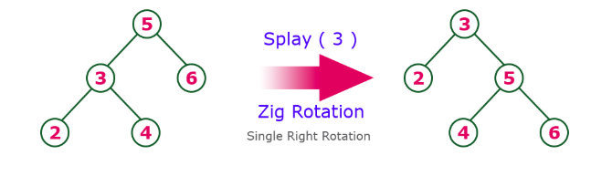
Rotations in Splay Tree
1. Zig Rotation
2. Zag Rotation
3. Zig - Zig Rotation
4. Zag - Zag Rotation
5. Zig - Zag Rotation
6. Zag - Zig Rotation
Zig Rotation:
The Zig Rotation in splay tree is similar to the single right rotation in AVL Tree rotations. In zig rotation, every node moves one position to the right from its current position. Consider the following example...

Slide 23
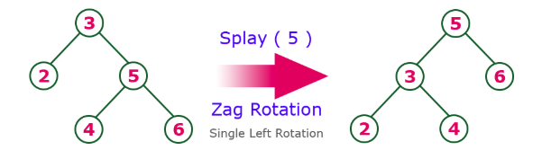
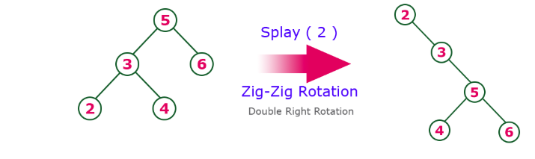
Zag Rotation
The Zag Rotation in splay tree is similar to the single left rotation in AVL Tree rotations. In zag rotation, every node moves one position to the left from its current position. Consider the following example...
Zig-Zig Rotation
The Zig-Zig Rotation in splay tree is a double zig rotation. In zig-zig rotation, every node moves two positions to the right from its current position. Consider the following example...

Slide 24
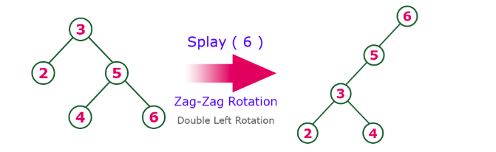
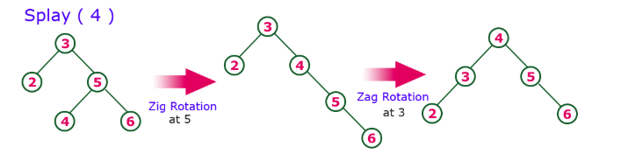
Zag-Zag Rotation
The Zag-Zag Rotation in splay tree is a double zag rotation. In zag-zag rotation, every node moves two positions to the left from its current position. Consider the following example.
Zig-Zag Rotation
The Zig-Zag Rotation in splay tree is a sequence of zig rotation followed by zag rotation. In zig-zag rotation, every node moves one position to the right followed by one position to the left from its current position. Consider the following example...

Slide 25
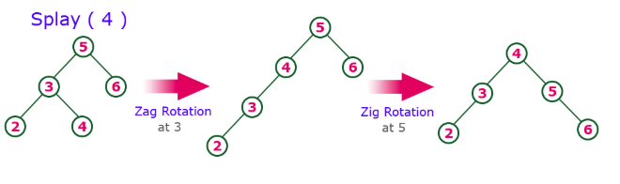
Zag-Zig Rotation
The Zag-Zig Rotation in splay tree is a sequence of zag rotation followed by zig rotation. In zag-zig rotation, every node moves one position to the left followed by one position to the right from its current position. Consider the following example...
Insertion Operation in Splay Tree
The insertion operation in Splay tree is performed using following steps...
Step 1 - Check whether tree is Empty.
Step 2 - If tree is Empty then insert the newNode as Root node and exit from the operation.
Step 3 - If tree is not Empty then insert the newNode as leaf node using Binary Search tree insertion logic.
Step 4 - After insertion, Splay the newNode

Slide 26
Deletion Operation in Splay Tree
The deletion operation in splay tree is similar to deletion operation in Binary Search Tree. But before deleting the element, we first need to splay that element and then delete it from the root position. Finally join the remaining tree using binary search tree logic.

Slide 27
Red - Black Tree Data structure:
Red Black Tree is a Binary Search Tree in which every node is colored either RED or BLACK.
In Red Black Tree, the color of a node is decided based on the properties of Red-Black Tree. Every Red Black Tree has the following properties.
Properties of Red Black Tree
Property #1: Red - Black Tree must be a Binary Search Tree.
Property #2: The ROOT node must be colored BLACK.
Property #3: The children of Red colored node must be colored BLACK. (There should not be two consecutive RED nodes).
Property #4: In all the paths of the tree, there should be same number of BLACK colored nodes.
Property #5: Every new node must be inserted with RED color.
Property #6: Every leaf (e.i. NULL node) must be colored BLACK.
Every Red Black Tree is a binary search tree but every Binary Search Tree need not be Red Black tree.

Slide 28
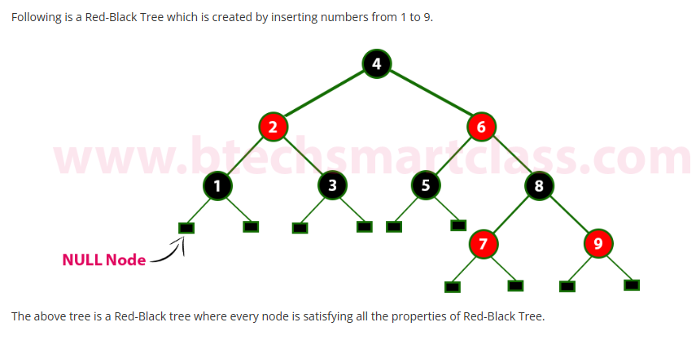
Example

Slide 29
Insertion into RED BLACK Tree:
Step 1 - Check whether tree is Empty.
Step 2 - If tree is Empty then insert the newNode as Root node with color Black and exit from the operation.
Step 3 - If tree is not Empty then insert the newNode as leaf node with color Red.
Step 4 - If the parent of newNode is Black then exit from the operation.
Step 5 - If the parent of newNode is Red then check the color of parentnode's sibling of newNode.
Step 6 - If it is colored Black or NULL then make suitable Rotation and Recolor it.
Step 7 - If it is colored Red then perform Recolor. Repeat the same until tree becomes Red Black Tree.
Deletion Operation in Red Black Tree
The deletion operation in Red-Black Tree is similar to deletion operation in BST. But after every deletion operation, we need to check with the Red-Black Tree properties. If any of the properties are violated then make suitable operations like Recolor, Rotation and Rotation followed by Recolor to make it Red-Black Tree.

Slide 30
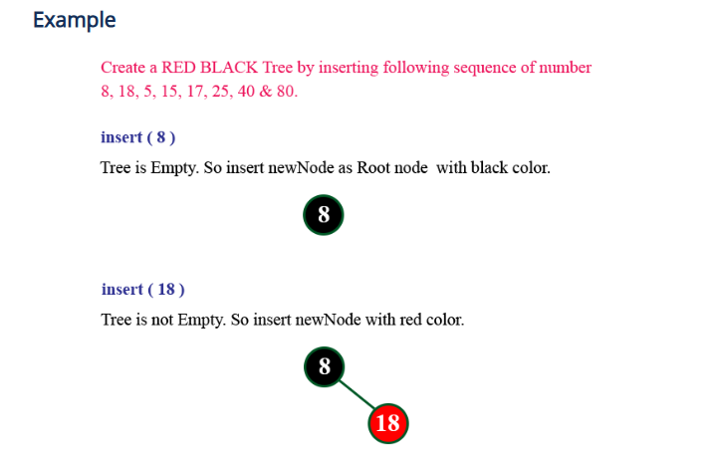
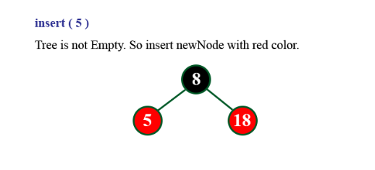

Slide 31
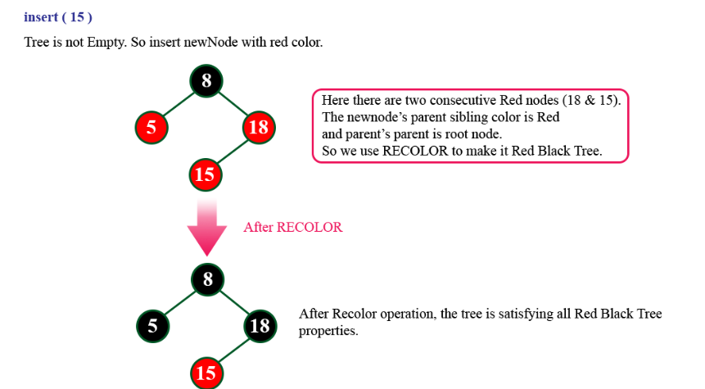

Slide 32
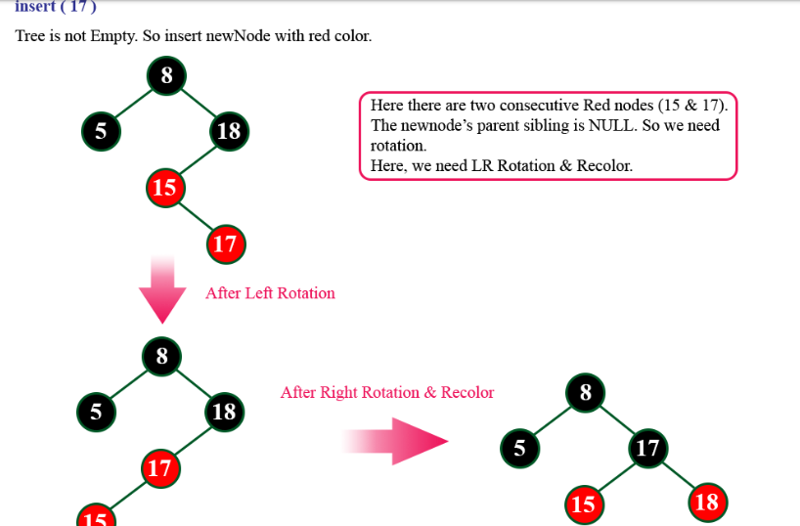

Slide 33
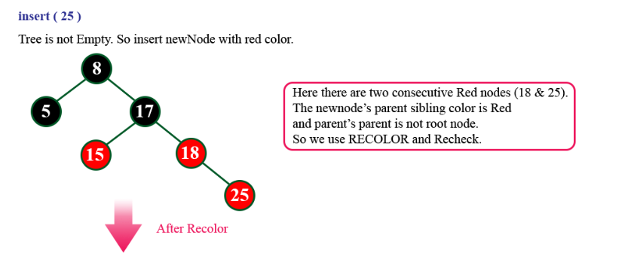
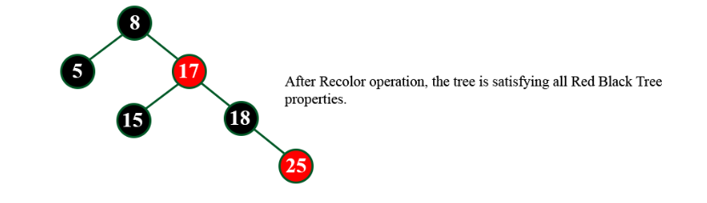

Slide 34
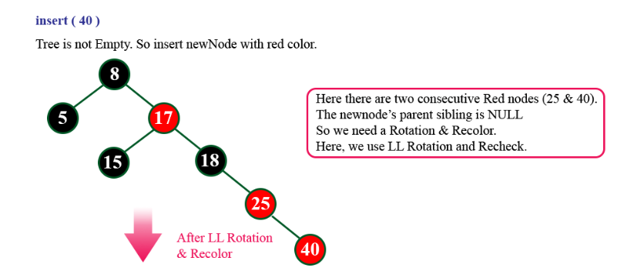
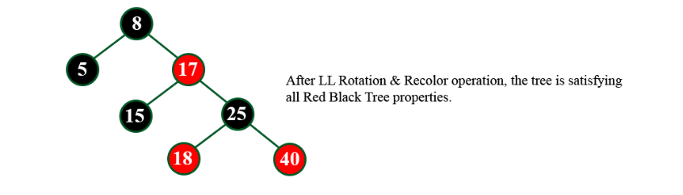

Slide 35
